Slide 1

Principles of
Operating System
Virtual Memory

Slide 2


Roadmap
Background
Demand Paging
Process Creation
Page Replacement
Allocation of Frames
Thrashing
Other Considerations

Slide 3
Background
Virtual memory: separation of user logical memory from physical memory.
  Only part of the program needs to be in memory for execution.
  Logical address space can therefore be much larger than physical address space.
  Allows address spaces to be shared by several processes.
  Allows for more efficient process creation.
Virtual memory can be implemented via:
  Demand paging
  Demand segmentation

Slide 4
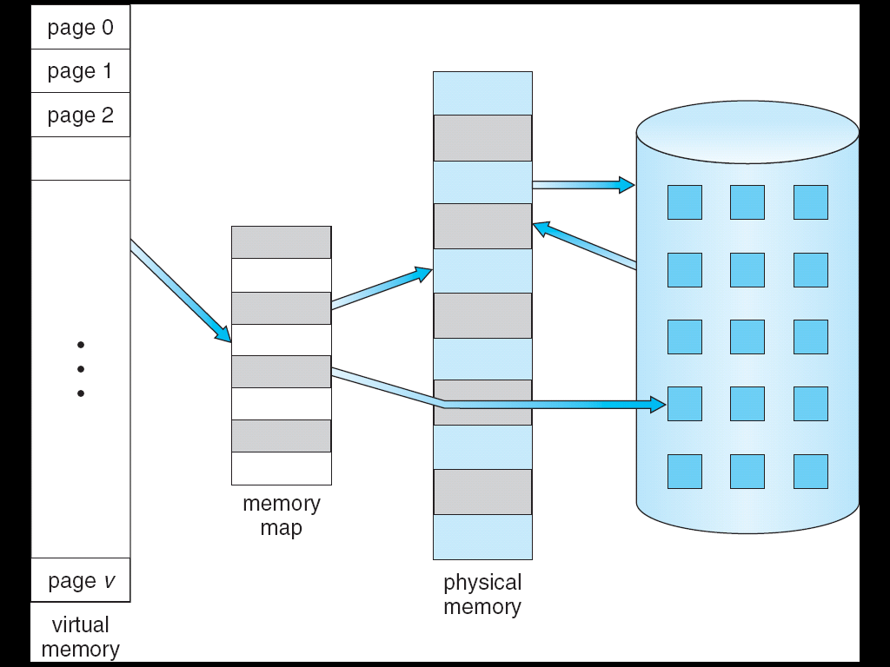
Virtual Memory That is Larger Than Physical Memory

Slide 5
Roadmap
Background
Demand Paging
Process Creation
Page Replacement
Allocation of Frames
Thrashing
Other Considerations

Slide 6
Demand Paging
Bring a page into memory only when it is needed.
  Less I/O needed
  Less memory needed
  Faster response
  More users
Page is needed ⇒ reference to it
  invalid reference ⇒ abort
  not-in-memory ⇒ bring to memory

Slide 7
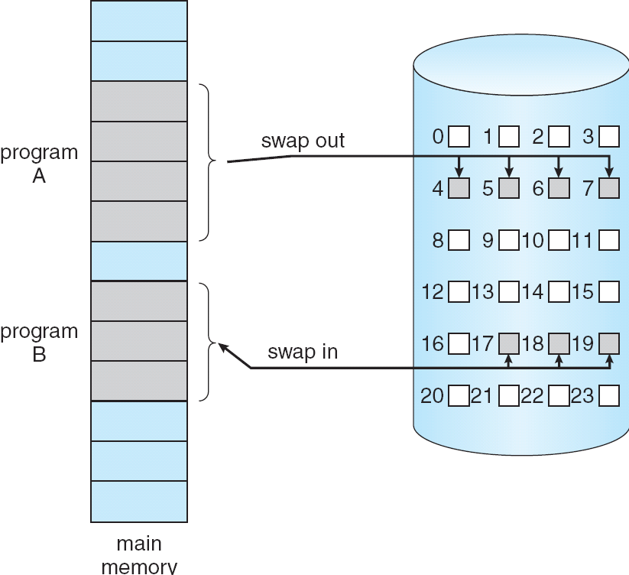
Transfer of a Paged Memory to Contiguous Disk Space

Slide 8
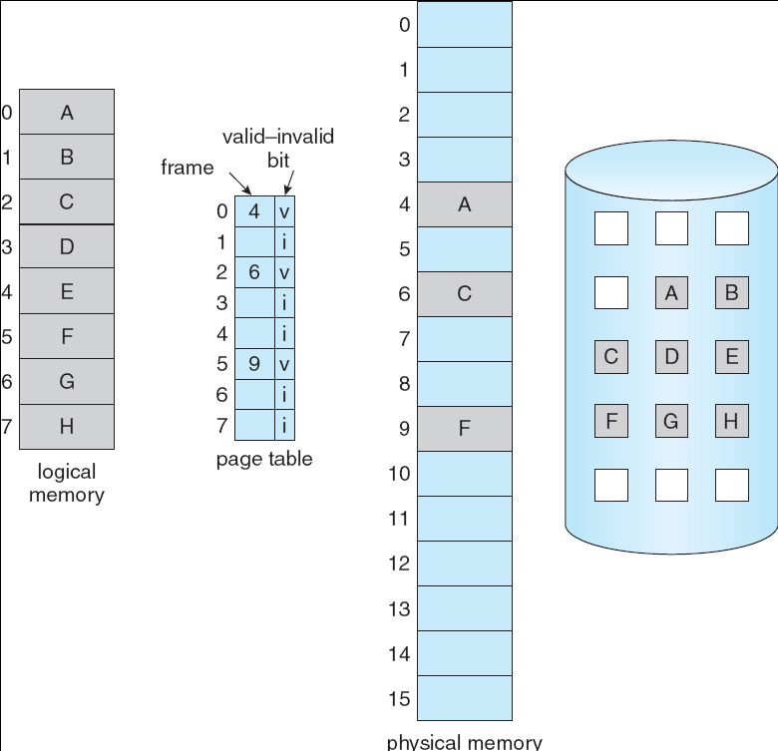
Valid-Invalid Bit
With each page table entry a valid–invalid bit is associated
  (1 ⇒ in-memory, 0 ⇒ not-in-memory)
  Initially valid–invalid bit is set to 0 on all entries.
Example of a page
table snapshot.
Frame #
valid-invalid bit
1
1
1
1
0

0
0
page table

Slide 9
Page Fault
If there is ever a reference to a page, first reference will trap to OS ⇒ page fault
  OS looks at another table to decide:
    Invalid reference ⇒ abort.
    Just not in memory.
  Get empty frame.
  Swap page into frame.
  Reset tables, validation bit = 1.
  Restart instruction: Least Recently Used

Slide 10

Steps in Handling a Page Fault

Slide 11
What happens if there is no free frame?
Page replacement: find some page in memory, but not really in use, swap it out.
  Algorithm
  Performance: want an algorithm which will result in minimum number of page faults.
Same page may be brought into memory several times.

Slide 12
Performance of Demand Paging
Page Fault Rate 0 ≤ p ≤ 1.0
  if p = 0 no page faults
  if p = 1, every reference is a fault
Effective Access Time (EAT)
EAT = (1 – p) x memory access
+ p (page fault interrupt
+ swap page out
+ swap page in
+ restart the process)

Slide 13
Demand Paging Example
Memory access time = 200 ns
Average page-fault service time = 8 ms
EAT = (1 – p) x 200 + p (8 ms)
= (1 – p) x 200 + p x 8,000,000
= 200 + p x 7,999,800
If one access out of 1,000 causes a page fault, then
EAT = 8.2 microseconds.

Slide 14
Roadmap
Background
Demand Paging
Process Creation
Page Replacement
Allocation of Frames
Thrashing
Other Considerations

Slide 15
Process Creation
Virtual memory allows other benefits during process creation:
  - Copy-on-Write
  - Memory-Mapped Files

Slide 16
Copy-on-Write
Copy-on-Write (COW) allows both parent and child processes to initially share the same pages in memory.
  If either process modifies a shared page, only then is the page copied.
COW allows more efficient process creation as only modified pages are copied.
Free pages are allocated from a pool of zeroed-out pages.

Slide 17
Memory-Mapped Files
Memory-mapped file I/O allows file I/O to be treated as routine memory access by mapping a disk block to a page in memory.
A file is initially read using demand paging. A page-sized portion of the file is read from the file system into a physical page. Subsequent reads/writes to/from the file are treated as ordinary memory accesses.
Also allows several processes to map the same file allowing the pages in memory to be shared.

Slide 18

Memory Mapped Files

Slide 19
Roadmap
Background
Demand Paging
Process Creation
Page Replacement
Allocation of Frames
Thrashing
Other Considerations

Slide 20
Page Replacement
Prevent over-allocation of memory by modifying page-fault service routine to include page replacement.
Page replacement completes separation between logical memory and physical memory - large virtual memory can be provided on a smaller physical memory.

Slide 21

Need For Page Replacement

Slide 22
Basic Page Replacement
Find the location of the desired page on disk.
Find a free frame:
  If there is a free frame, use it.
  If there is no free frame, use a page replacement algorithm to select a victim frame.
Read the desired page into the (newly) free frame. Update the page and frame tables.
Restart the process.

Slide 23

Page Replacement
Use modify (dirty) bit to reduce overhead of page transfers: only modified pages are written to disk.

Slide 24
Page Replacement Algorithms
Want lowest page-fault rate.
Evaluate algorithm by running it on a particular string of memory references (reference string) and computing the number of page faults on that string.

Slide 25
reference string
How to select a reference string (real recorded data or simulated data)
How to reduce the number of data
  Just consider the page number only, rather than the entire address.
  If we have a reference to a page p, then any immediately following references to page p will never cause a page fault.
An example: 0100, 0432,0101,0612, 0102,0103,0104,0611 ➔ 1,4,1,6,1,6

Slide 26

Graph of Page Faults Versus The Number of Frames

Slide 27

First-In-First-Out (FIFO) Algorithm
A FIFO replacement algorithm associates with each page the time when that page was brought into memory.
Reference string: 7, 0, 1, 2, 0, 3, 0, 4, 2, 3, 0, 3, 2, 1, 2, 0, 1, 7, 0, 1

Slide 28

Belady’s Anomaly
For some page-replacement algorithms, the page-fault rate may increase as the number of allocated frames increases.
Reference string: 1, 2, 3, 4, 1, 2, 5, 1, 2, 3, 4, 5

Slide 29

Optimal Algorithm
Replace page that will not be used for longest period of time.
3 frames example 7, 0, 1, 2, 0, 3, 0, 4, 2, 3, 0, 3, 2, 1, 2, 0, 1, 7, 0, 1
  How do you know this?
  Used for measuring how well your algorithm performs.

Slide 30

Least Recently Used (LRU) Algorithm
LRU chooses that page that has not been used for the longest period of time.
Reference string: 7, 0, 1, 2, 0, 3, 0, 4, 2, 3, 0, 3, 2, 1, 2, 0, 1, 7, 0, 1

Slide 31

LRU Algorithm (Cont.)
Counter implementation
  Every page entry has a counter; every time page is referenced through this entry, copy the clock into the counter.
  When a page needs to be changed, look at the counters to determine which are to change.
Stack implementation: keep a stack of page numbers in a double link form:
  Page referenced:
    move it to the top
    requires 6 pointers to be changed
  No search for replacement

Slide 32
LRU Approximation Algorithms (1/2)
Reference bit
Uses a reference bit set (8bit) by hardware when the page is touched. Then when a fault occurs, pick a page that hasn't been referenced.
  With each page associate a bit, initially = 0
  When page is referenced bit set to 1.
  Replace the one which is smallest.
  e.g. 00000000 - did not use in 8 times
  11111110 - used in latest 7 times

Slide 33

LRU Approximation Algorithms (2/2)
Second-Chance (clock) Page-Replacement Algorithm
  Need reference bit.
  Clock replacement.
  If page to be replaced (in clock order) has reference bit = 1. then:
    set reference bit 0.
    leave page in memory.
    replace next page, subject to same rules.

Slide 34
Counting Algorithms
Keep a counter of the number of references that have been made to each page.
  LFU Algorithm (least frequently used page-replacement algorithm): replaces page with smallest count.
  MFU Algorithm (most frequently used page-replacement algorithm): based on the argument that the page with the smallest count was probably just brought in and has yet to be used.
Both are not common.

Slide 35
Roadmap
Background
Demand Paging
Process Creation
Page Replacement
Allocation of Frames
Thrashing
Other Considerations

Slide 36
Allocation of Frames
Each process needs minimum number of pages.
Two major allocation schemes.
  fixed allocation
  priority allocation

Slide 37

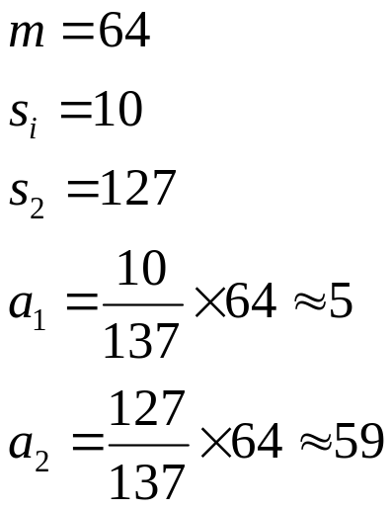
Fixed Allocation
Equal allocation: e.g., if 100 frames and 5 processes, give each 20 pages.
Proportional allocation: Allocate according to the size of process.

Slide 38
Priority Allocation
Use a proportional allocation scheme using priorities rather than size.
If process P_{i} generates a page fault,
  select for replacement one of its frames.
  select for replacement a frame from a process with lower priority number.

Slide 39
Global vs. Local Allocation
Global replacement – process selects a replacement frame from the set of all frames; one process can take a frame from another.
Local replacement – each process selects from only its own set of allocated frames.

Slide 40
Roadmap
Background
Demand Paging
Process Creation
Page Replacement
Allocation of Frames
Thrashing
Other Considerations

Slide 41
Thrashing
If a process does not have “enough” pages, the page-fault rate is very high. This leads to:
  low CPU utilization.
  operating system thinks that it needs to increase the degree of multiprogramming.
  another process added to the system.
Thrashing: a process is busy swapping pages in and out.

Slide 42

Thrashing (cont.)

Slide 43
Demand Paging and Thrashing
Why does demand paging work?
Locality model
  Process migrates from one locality to another
  Localities may overlap
Why does thrashing occur?
Σ size of locality > total memory size

Slide 44

Locality In A Memory-Reference Pattern

Slide 45
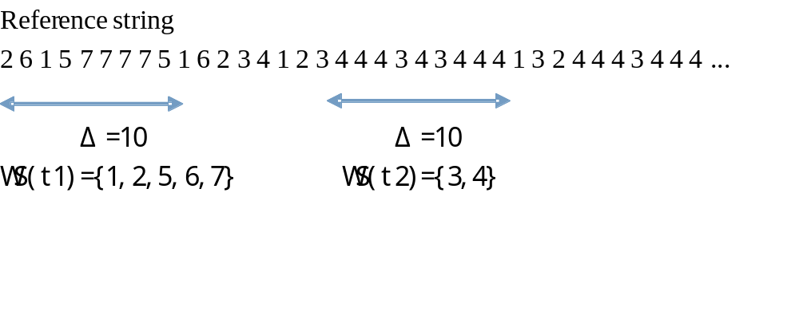
Working-Set Model
Δ is working-set window, a fixed number of page references.
WSS_{i} (working set of Process P_{i}) =
total number of pages referenced in the most recent Δ (varies in time)
  if Δ too small will not encompass entire locality.
  if Δ too large will encompass several localities.
  if Δ = ∞ ⇒ will encompass entire program.
D = Σ WSS_{i} ≡ total demand frames
if D > m ⇒ Thrashing
Policy if D > m, then suspend one of the processes.

Slide 46
Roadmap
Background
Demand Paging
Process Creation
Page Replacement
Allocation of Frames
Thrashing
Other Considerations

Slide 47
Other Considerations
Prepaging
Page size selection
  fragmentation
  table size
  I/O overhead
  locality

Slide 48
Other Considerations (Cont.)
TLB Reach - The amount of memory accessible from the TLB.
TLB Reach = (TLB Size) X (Page Size)
Ideally, the working set of each process is stored in the TLB. Otherwise there is a high degree of page faults.

Slide 49
Increasing the Size of the TLB
Increase the Page Size. This may lead to an increase in fragmentation as not all applications require a large page size.
Provide Multiple Page Sizes. This allows applications that require larger page sizes the opportunity to use them without an increase in fragmentation.

Slide 50
Other Considerations (Cont.)
Program structure
  A Java Program
  int A[][] = new int[128][128];
  Each row is stored in one page
  Program 1 for (j = 0; j < A.length; j++)
  for (i = 0; i < A.length; i++)
  A[i,j] = 0;
  128x 128page faults
  Program 2 for (i = 0; i < A.length; i++)
  for (j = 0; j < A.length; j++)
  A[i,j] = 0;
  128page faults

Slide 51
Other Considerations (Cont.)
I/O Interlock – Pages must sometimes be locked into memory.
Consider I/O. Pages that are used for copying a file from a device must be locked from being selected for eviction by a page replacement algorithm.

Slide 52

Reason Why Frames Used For I/O Must Be In Memory

Slide 53
Keystone
Demand Paging
Page Replacement

Slide 54
Homework
Consider the following page reference string:
1,2,3,4,2,1,5,6,2,1,2,3,7,6,3,2,1,2,3,6.
How many page faults would occur for the following replacement algorithms, assuming
one, two, three, four, five, six, or seven frames? Remember all frames are initially empty,
So your first unique pages will all cost one fault each.
  _x000f_ LRU replacement
  _x000f_ FIFO replacement
  _x000f_ Optimal replacement

Slide 55
Principles of
Operating System
End of Virtual Memory

